Slide 1

Big Data Analytics
UNIT - 1

Slide 2


Slide 3
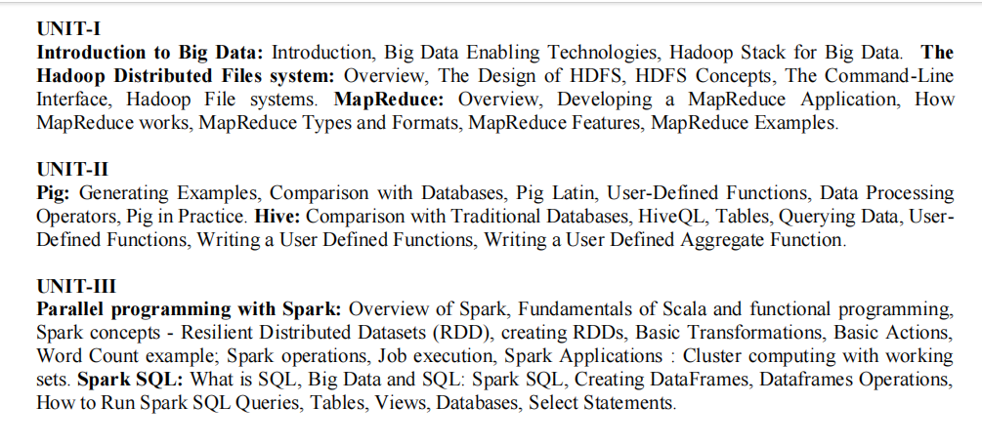

Slide 4
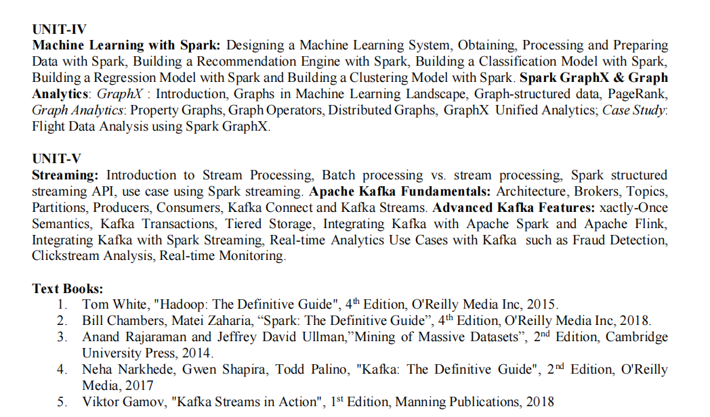

Slide 5
UNIT-1
Introduction to Big Data: Introduction, Big Data Enabling Technologies Hadoop Stack for Big Data.
The Hadoop Distributed Files system: Overview, The Design of HDFS, HDFS Concepts, The Command-Line Interface, Hadoop File systems. MapReduce: Overview, Developing a MapReduce Application, How MapReduce works, MapReduce Types and Formats, MapReduce Features, MapReduce Examples.

Slide 6


Slide 7
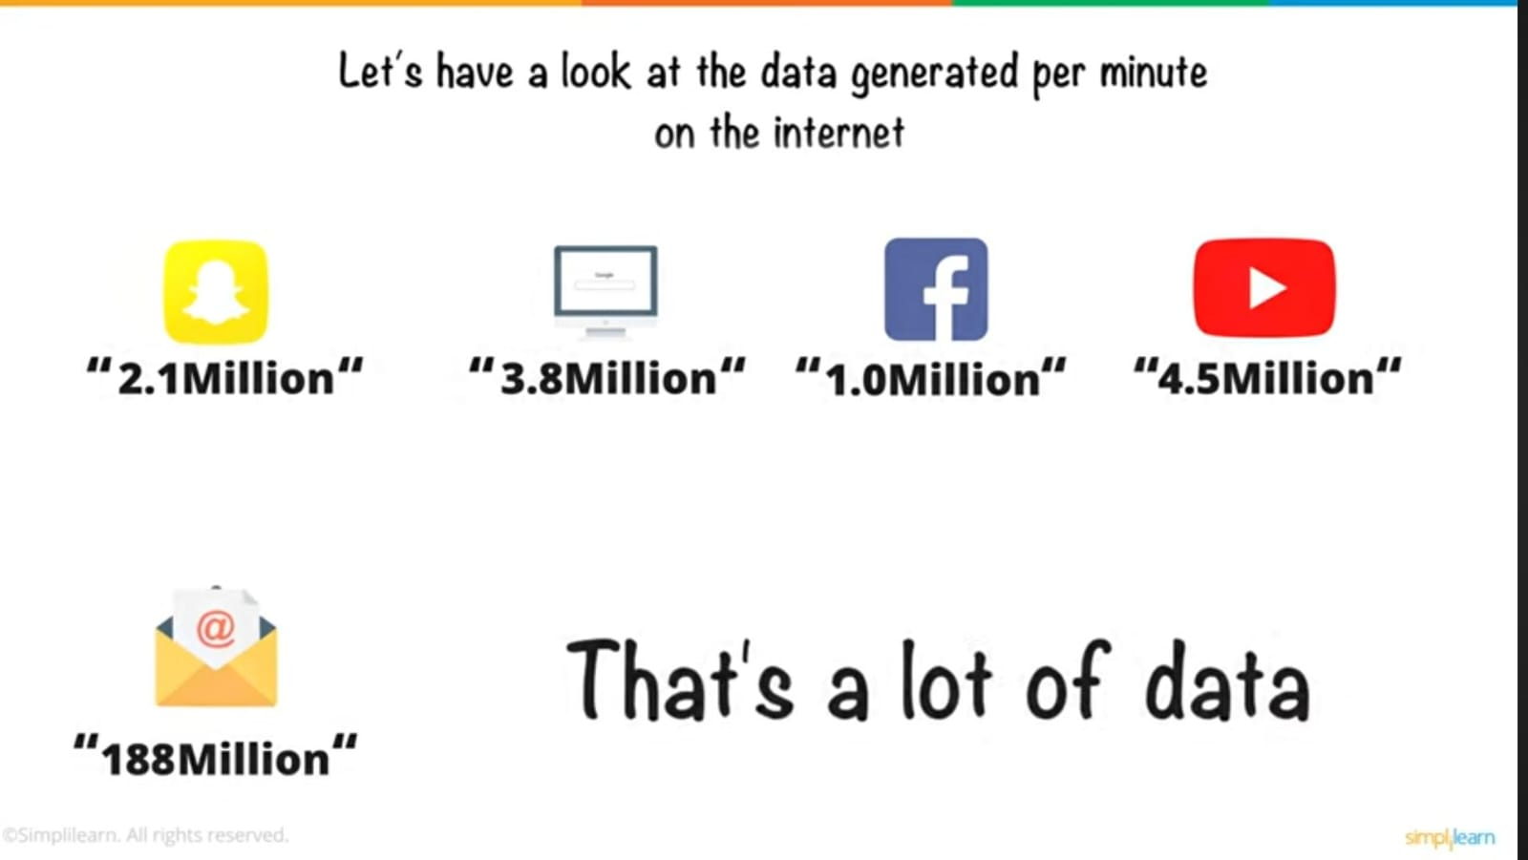

Slide 8
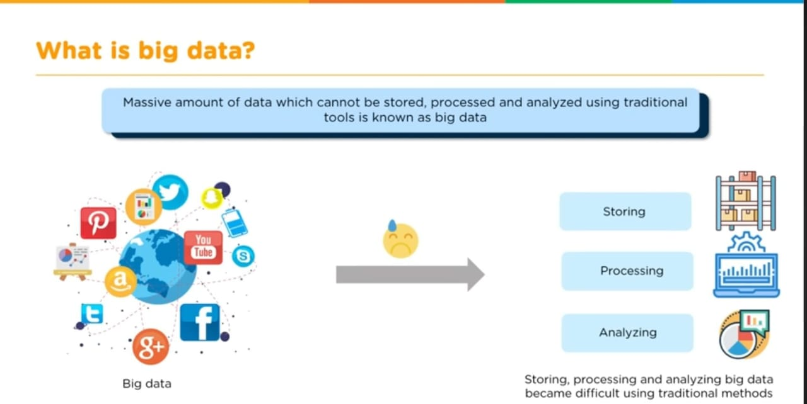

Slide 9
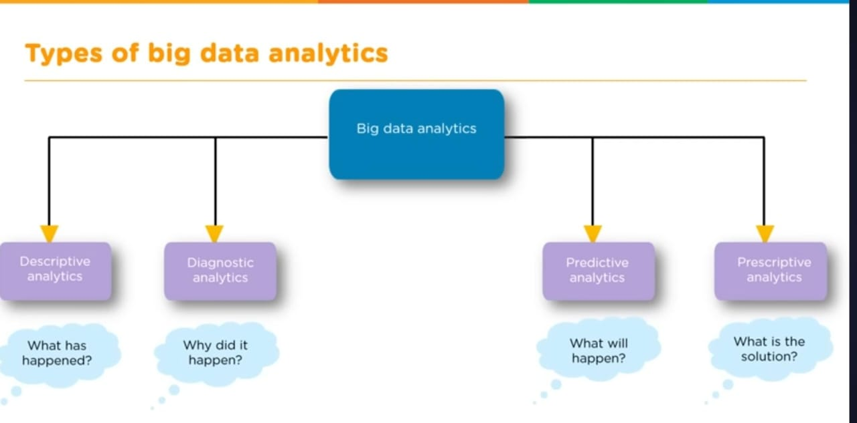

Slide 10
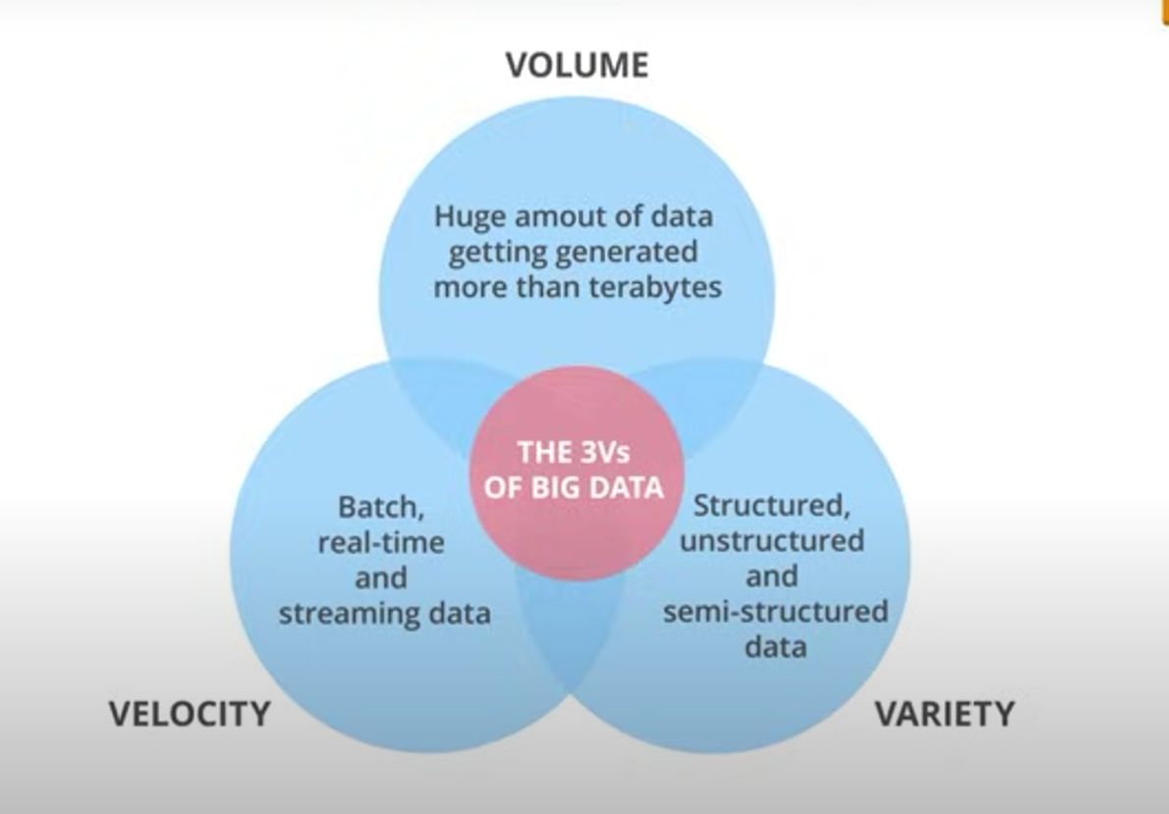
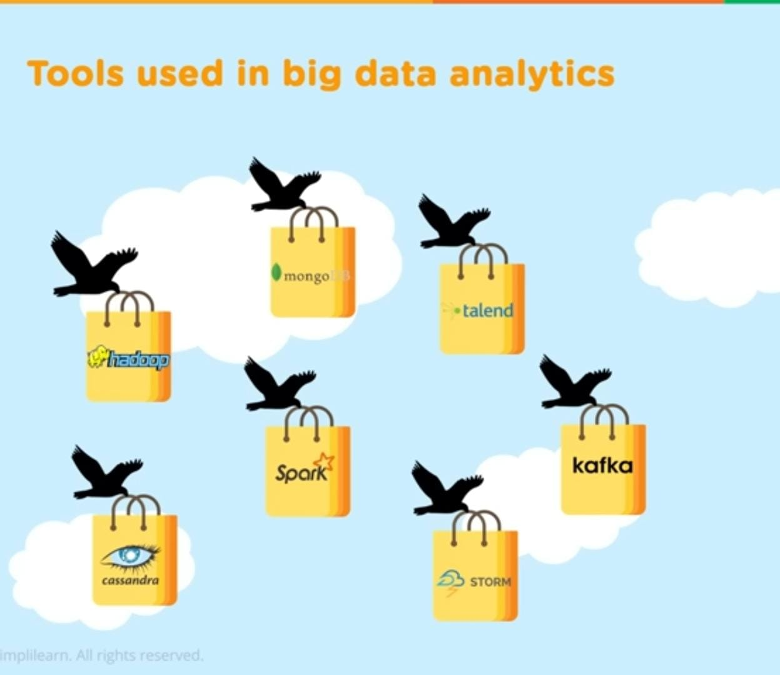

Slide 11
Big Data Analytics
Big Data
Collection of datasets that cannot be handled by using the traditional data processing tools.
Big Data Analytics
Analyzing Big Data to extract informative patters from it.

Slide 12
Sample Use Case of Big Data - Banking System
Stakeholders Generate Data Access the analyzed
Data
Types of Data
Structured
Semi-Structured
Unstructured
Tools & Technologies
Storing, Processing,
Retrieving and Analyzing
Information perceived Reports Generated Graphs
Tables

Slide 13
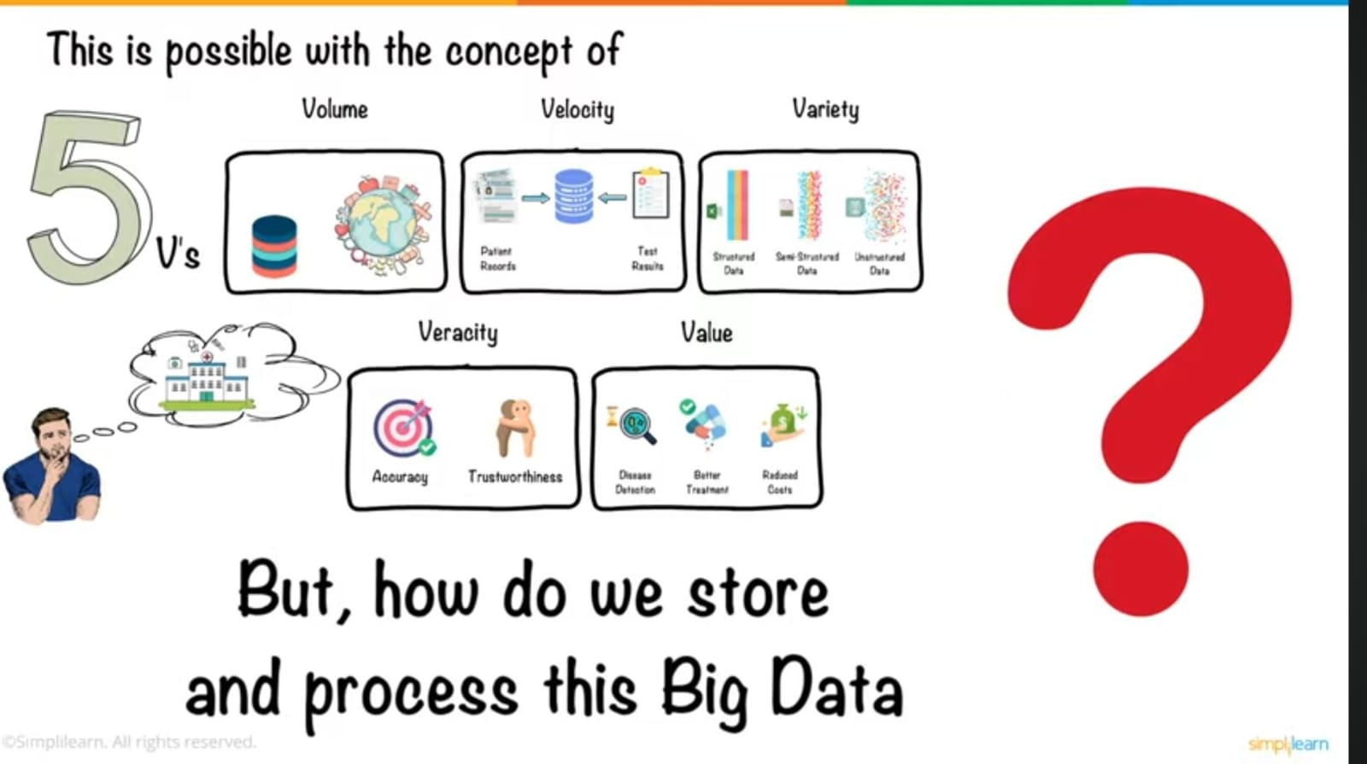

Slide 14
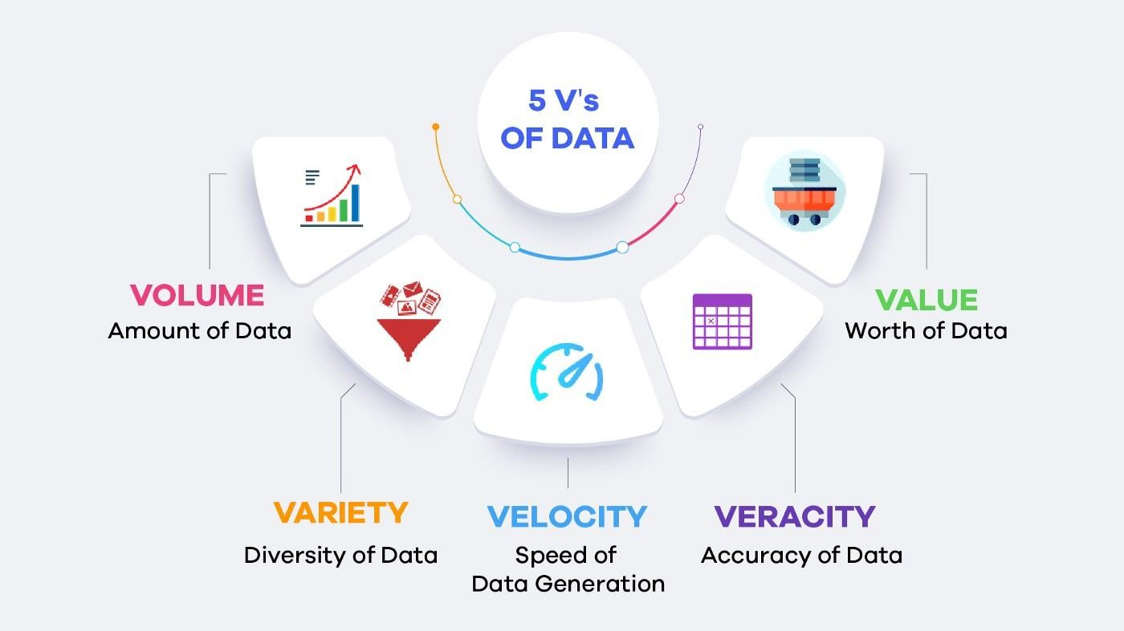
The 5 V's of Big Data

Slide 15
Volume
8 bits
Byte
10 ³
Kilo Byte (1KB)
Data ranging from Zetta Byte is usually referred to Big Data
10 ⁶
Mega Byte (1MB)
10 ⁹
Giga Byte (1GB)
₁₀ 12
Tera Byte (1TB)
₁₀ 15
Peta Byte (1PB)
₁₀ 18
Exa Byte (1 EB)
₁₀ 21
Zetta Byte (1ZB)
₁₀ 24
Yotta Byte (1YB)
₁₀ 27
Bronto Byte (BB)

Slide 16
Velocity
The rate at which a system is generating the large amounts of data
Walmart handles 1 million customer transactions per hour
Facebook 40 billion photos from its user base
handles
inserts
500 TBs of data each day
Stores, Processes and Analyzes
generates
30 + PBs of Data
240 TB data for every 6-8 hours of flight
Flight

Slide 17

Variety
Variety of Sources
People - Using Mobile devices
Machines - Sensors / IOT
^{d}O^{e}r^{v}g^{i}a^{c}n^{e}i^{s}zations -- Generate data by capturing the customer transactions
Ubiquitous Computing
The ability to compute/analyze data at any time from any where using any device
Structured
Semi-Structured Unstructured

Slide 18
Value
Whether the data being analyzed results in some meaningful information
Statistical ,Hypothetical, Correlational

Slide 19
Veracity
Authenticity, Reputation, Authorization

Slide 20
Big Data Life Cycle
Business case Evaluation
Visualization
Identification of Data
Data Analysis
Data Filtering
Data Aggregation
Data Extraction

Slide 21
Types of BDA
1. Descriptive Analytics What happened?
Ex: A chemical company Dow found out the underutilized area and thus saved 4 million dollars annually
2. Diagnostic Analytics
How it happened?
Ex: Airlines --- customer dropouts
3. Predictive Analytics
Ex: Paypal --
What is likely to happen?
Fraudulent transaction detection before it happens
4. Prescriptive Analytics What can be done?
Ex: Airlines – Automatically adjust flight fares depending upon the season

Slide 22
IT Use cases
Log Analytics
Fraud Detection Pattern
Social Media/ Customer Sentiment Analysis Pattern

Slide 23
Log Analytics
Log Analytics is the assessment of recorded information about the events collected from one or more computer , network and application OS.
An event is an identifiable or significant occurrence upon a h/w or s/w. Event can be generated by an user or by a computer
A log analytics s/w collects and checks the logs such as error logs.
These logs help the organizations diagnose an issue such as he location, time of
event occurrence e.t.c.
A state-of-the-art log analytics system is Amazon Open Search system Service(AOSS)

Slide 24
Fraud Detection Pattern
Traditional approach
Rule based systems flags potentially fraudulent systems
Confirm the credit card transaction with customer
BDA approach
Incorporate domain experts knowledge in form of rules
Uses past Fraudulent transactions to apply diagnostic analysis Performed on No Sampling basis

Slide 25
Customer Sentiment Analysis
Companies monitor what people are saying about them in social media and respond
appropriately — and if they do not, they quickly lose customers.
Performed by collecting large set of social media data like twitter, facebook, youtube Customer Sentiment can take either of the following forms
Positive
Negative
Neutral

Slide 26
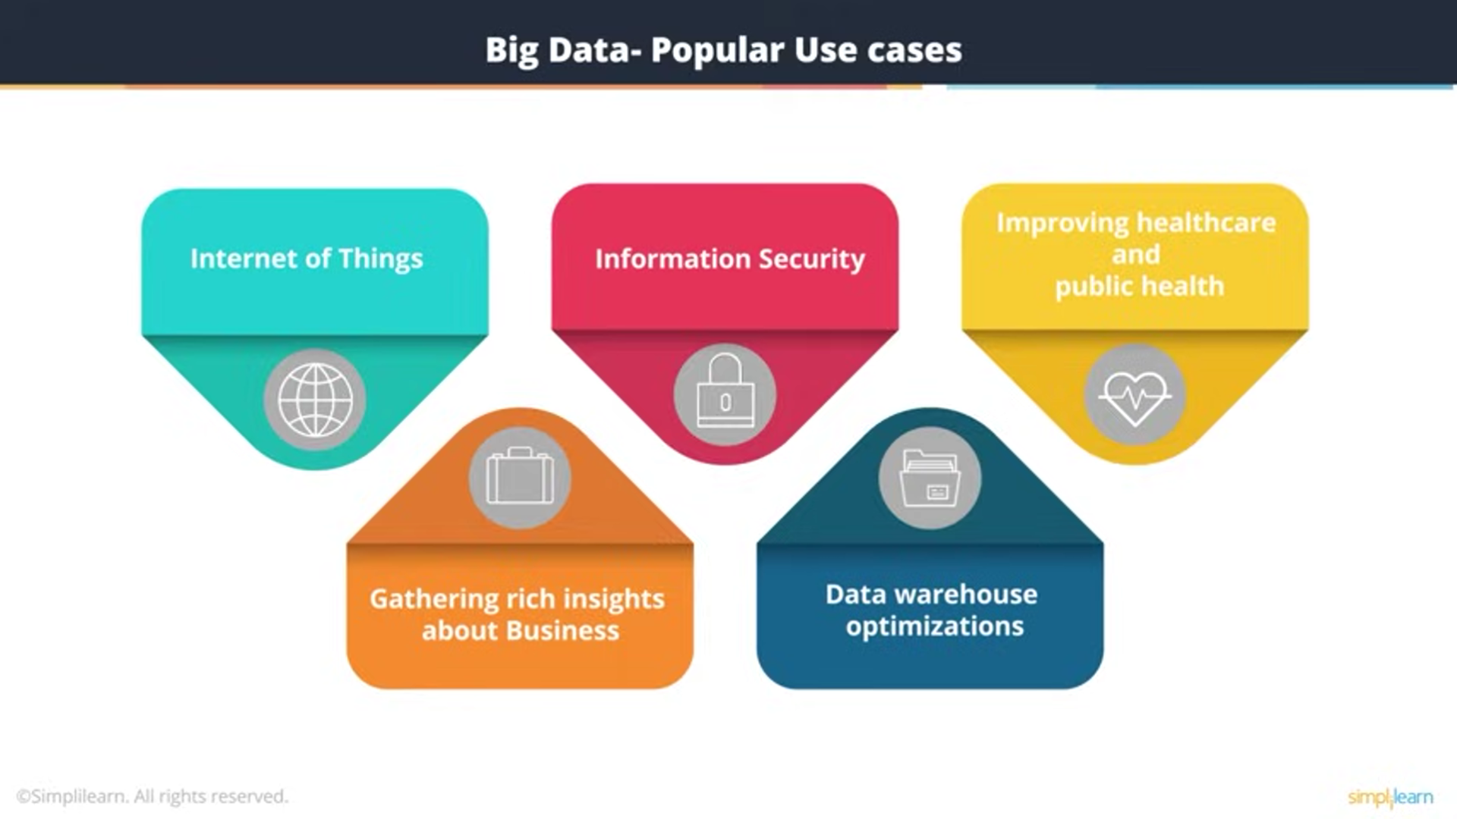

Slide 27
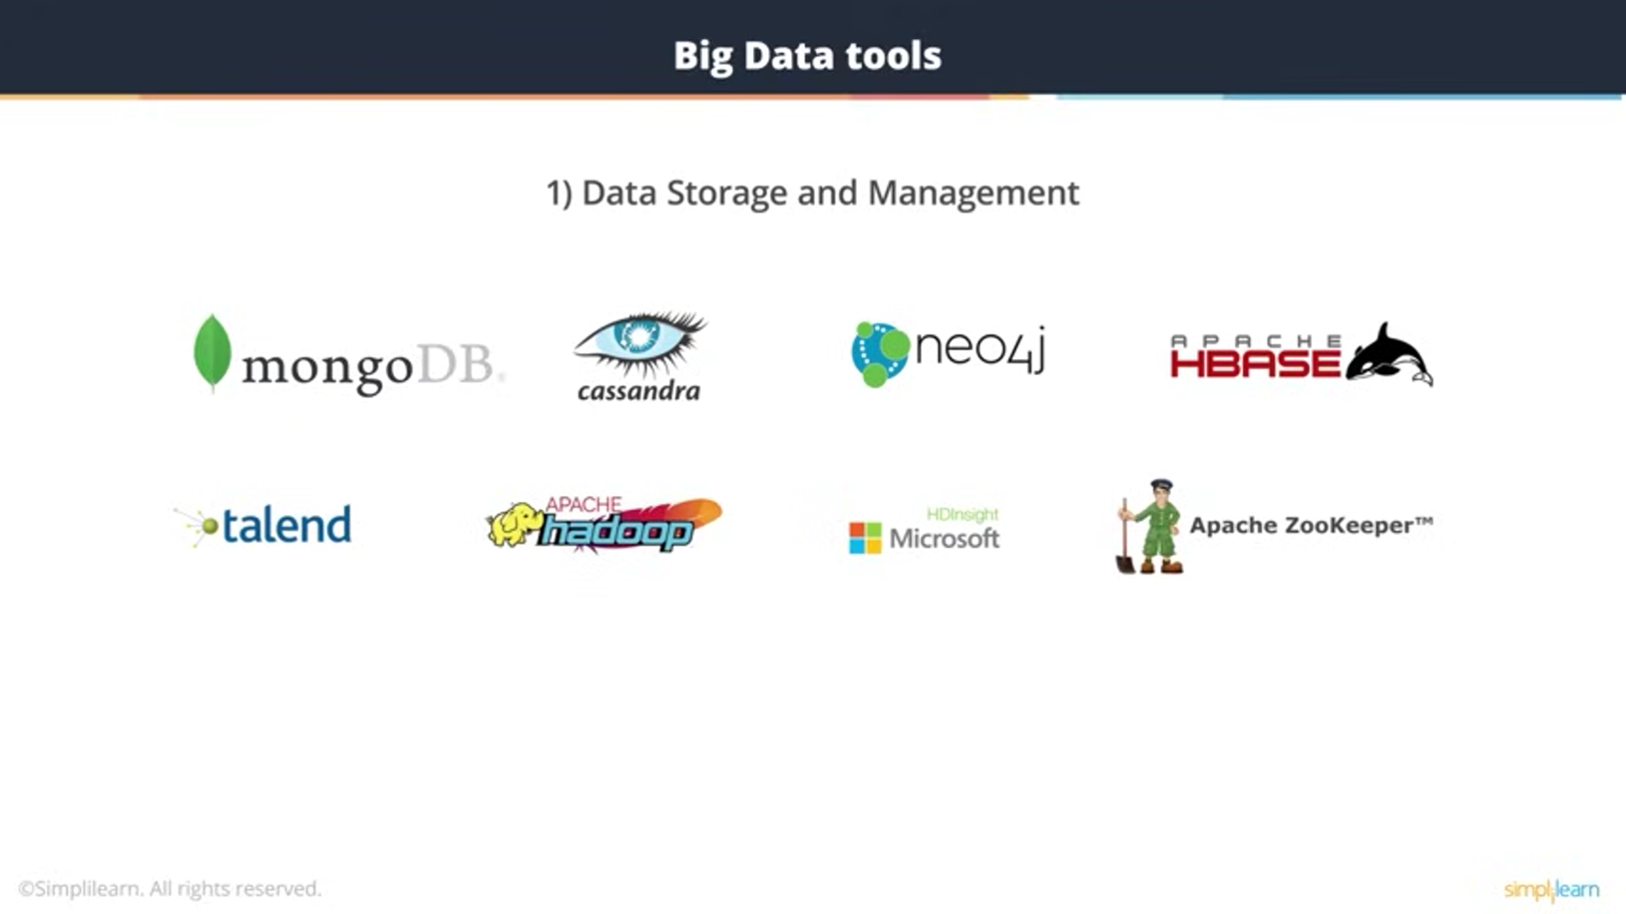

Slide 28
Semi-Structured Data
FB page
Structured Data
Unstructured Data
EMS
Survilliance
Security
CRM
Customer Care Log
MySQL
JSON
Customer Sentiment Analysis
Media
IOT/
Sensory Data
Partners
XML
Flat File
Oracle
Core Data
ET
Distribu^{L}ted Storage
Scala
NoSQL
Mongo DB
Hadoop
HDFS
Map Reduce
Spark
New Simpler Programming Framework
Processed Storage
Faster Real-Time
Data Analysis
Pig HIVE
Data Analysis

Slide 29
Issues
DATA :
We live in the data age. It’s not easy to measure the total volume of data stored electronically, but an IDC estimate put the size of the “digital universe” at 4.4 zettabytes in 2013 and is forecasting a tenfold growth by 2020 to 44 zettabytes.
A zettabyte is 10²¹ bytes, or equivalently one thousand exabytes, one million petabytes, or one billion terabytes. That’s more than one disk drive for every person in the world

Slide 30
Issues
The volume of data being made publicly available increases every year, too. Organizations no longer have to merely manage their own data; success in the future will be dictated to a large extent by their ability to extract value from other organizations’ data.
Initiatives such as Public Data Sets on Amazon Web Services and Infochimps.org
Data Storage and Analysis

Slide 31
Using Hard Drives
The first problem to solve is hardware failure: as soon as you start using many pieces of hardware, the chance that one will fail is fairly high. A common way of avoiding data loss is through replication: redundant copies of the data are kept by the system so that in the event of failure, there is another copy available. This is how RAID works, for instance, although Hadoop’s filesystem, the Hadoop Distributed Filesystem (HDFS), takes a slightly different approach, as you shall see later.
The second problem is that most analysis tasks need to be able to combine the data in some way, and data read from one disk may need to be combined with data from any of the other 99 disks. Various distributed systems allow data to be combined from multiplesources, but doing this correctly is notoriously challenging.
MapReduce provides a programming model that abstracts the problem from disk reads and writes, transforming it into a computation over sets of keys and values. — the map and the reduce — and it’s the interface between the two where the “mixing” occurs.
Like HDFS, MapReduce has built-in reliability.In a nutshell, this is what Hadoop provides: a reliable, scalable platform for storage and analysis. What’s more, because it runs on commodity hardware and is open source, Hadoop is affordable.

Slide 32

Introduction to Hadoop
Hadoop is a programming framework that provides distributed storage and parallel processing of large data using commodity hardware.
History of Hadoop
In 2003 google published the concept of google file system(GFS) which was distributed in nature.
In 2005 , the Apache foundation implemented GFS in terms of Hadoop Distributed File System(HDFS) MapReduce Processing and released the first version of Hadoop, Hadoop 0.1.0 in the year 2006.
Actual Hadoop developers are Dough Cutting and Mike Cafarella. Dough Cutting named hadoop after his son's toy elephant.

Slide 33
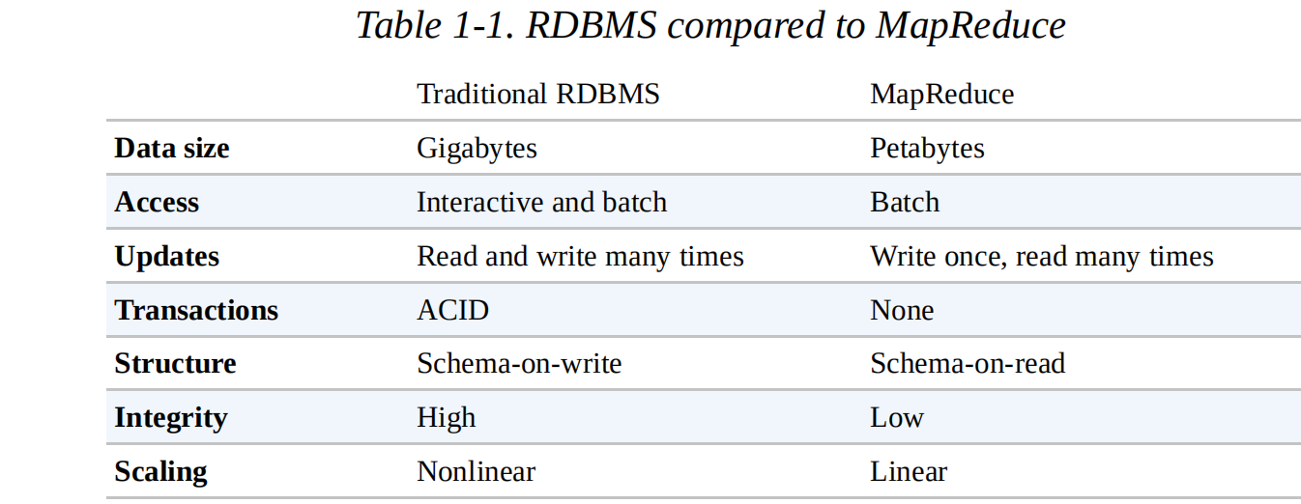

Slide 34
Why Hadoop:
Hadoop and an RDBMS is the amount of structure in the datasets on which they operate.Hadoop works well on unstructured or semi-structured data because it is designed to interpret the data at processing time (so called schema on-read). This provides flexibility and avoids the costly data loading phase of an RDBMS, since in Hadoop it is just a file copy.

Slide 35
Relational data is often normalized to retain its integrity and remove redundancy.Normalization poses problems for Hadoop processing because it makes reading a record a nonlocal operation, and one of the central assumptions that Hadoop makes is that it is possible to perform (high-speed) streaming reads and writes.
Eg: A web server log is a good example
MapReduce — and the other processing models in Hadoop — scales linearly with the sizeof the data. Data is partitioned, and the functional primitives (like map and reduce) can work in parallel on separate partitions.

Slide 36
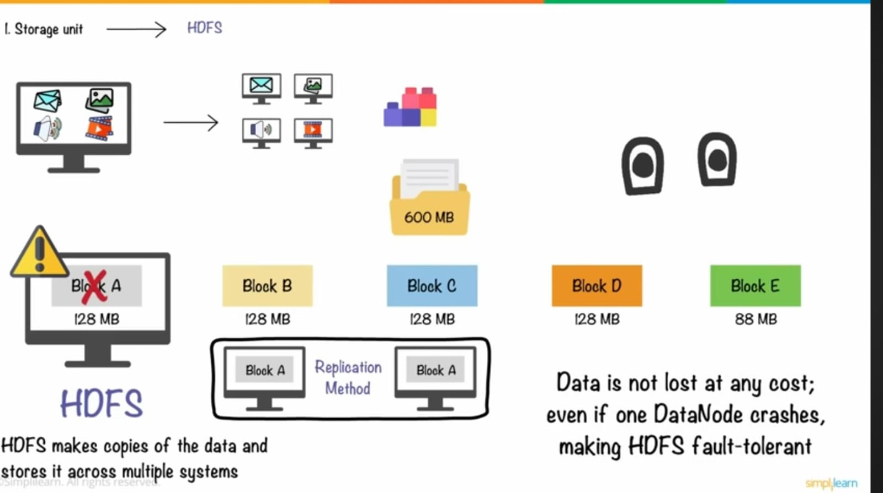

Slide 37
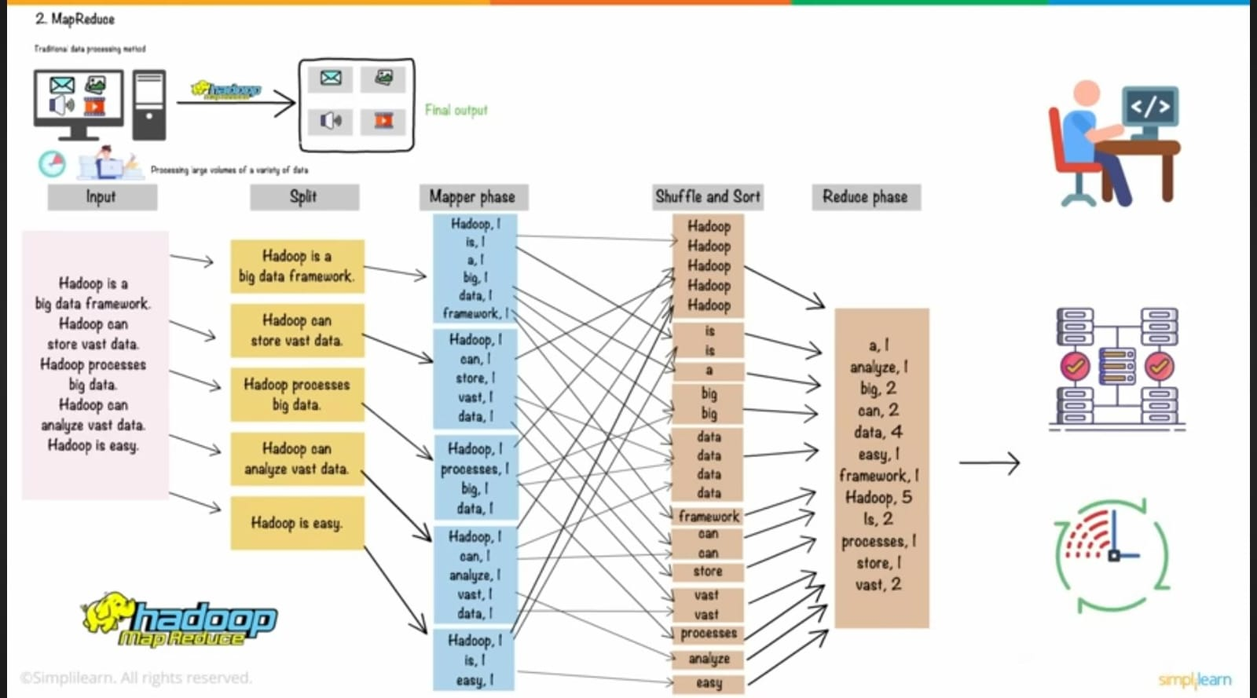

Slide 38
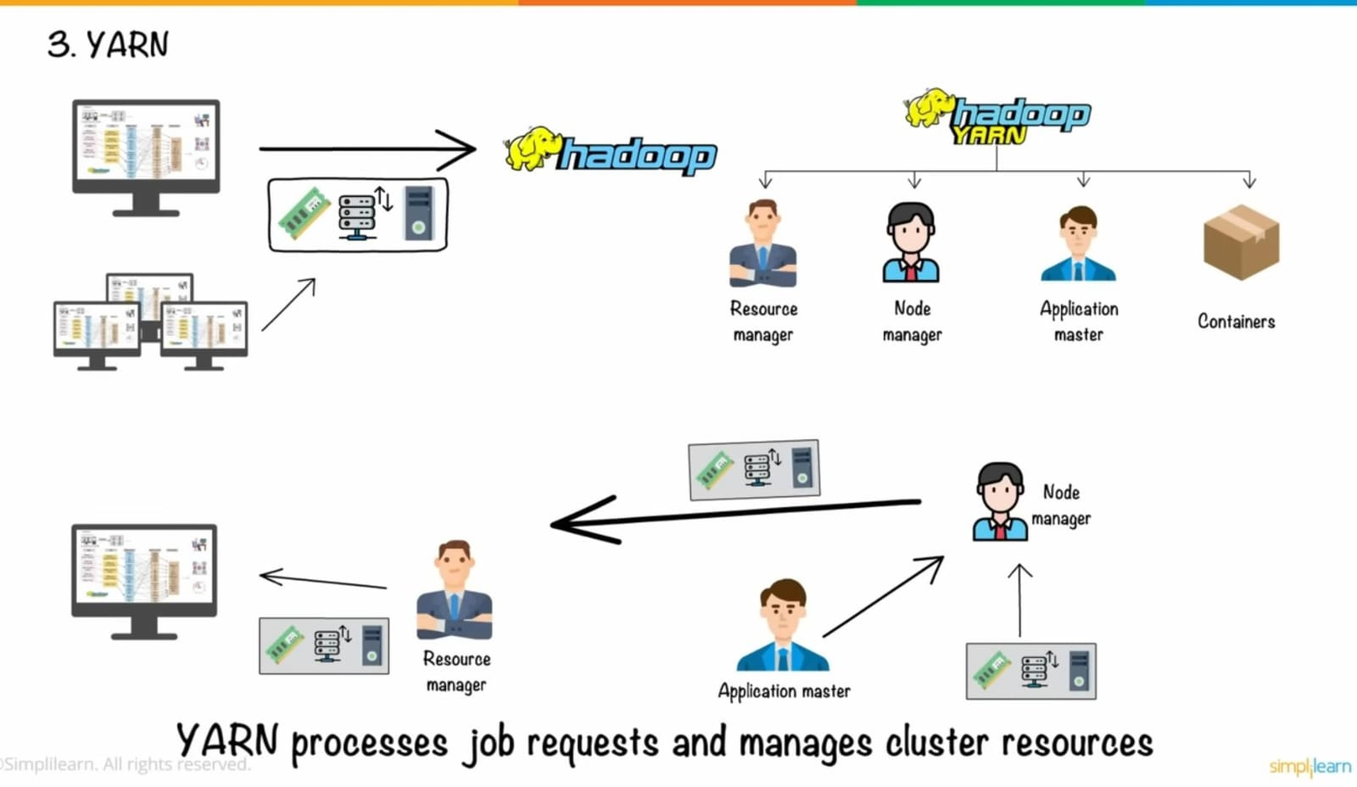

Slide 39
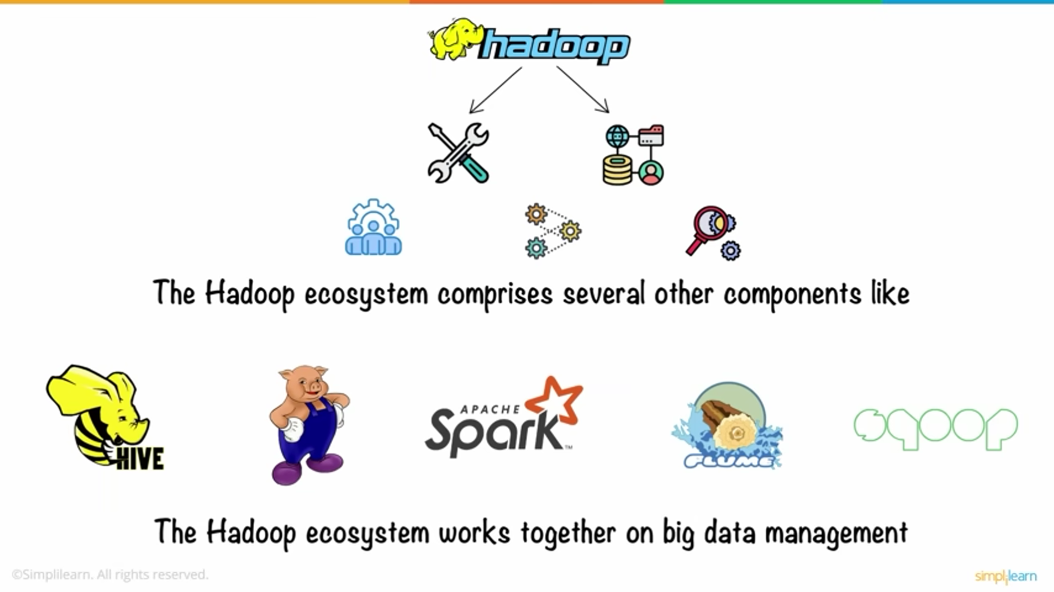

Slide 40
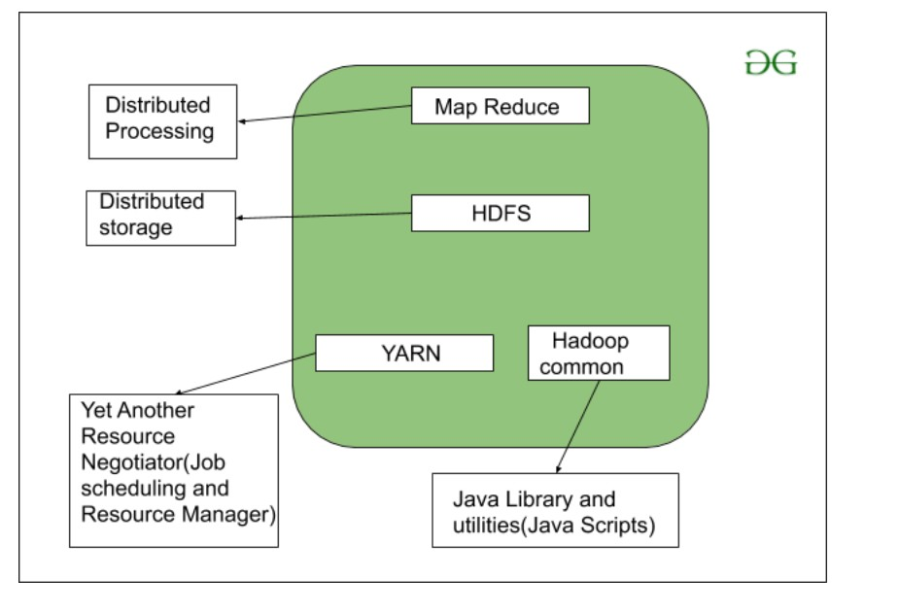
Hadoop Architecture

Slide 41
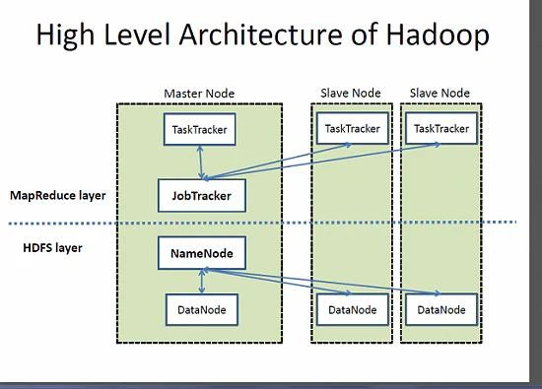
https://hadoop.apache.org/docs/r1.2.1/hdfs_design.html

Slide 42
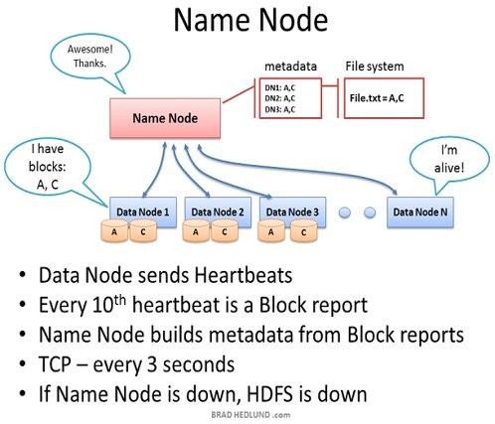
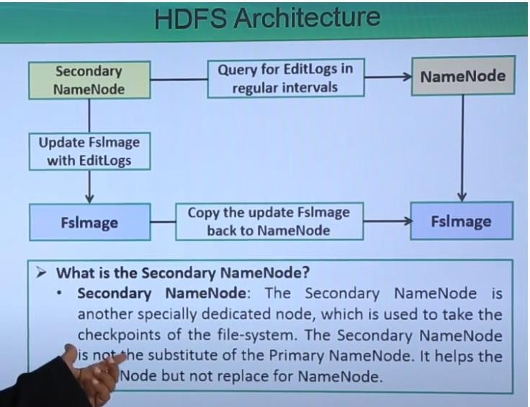
Name node in HDFS

Slide 43
HDFS - Hadoop Distributed File System
HDFS stores the files/data in clusters of nodes. Nodes are basically computers connected
in LAN with a server maintaining the metadata about all these nodes.
Advantages:
Inexpensive Immutable
Reliable data storage
Block structured and scalable
Disadvantages:
No suitable for smaller datasets

Slide 44
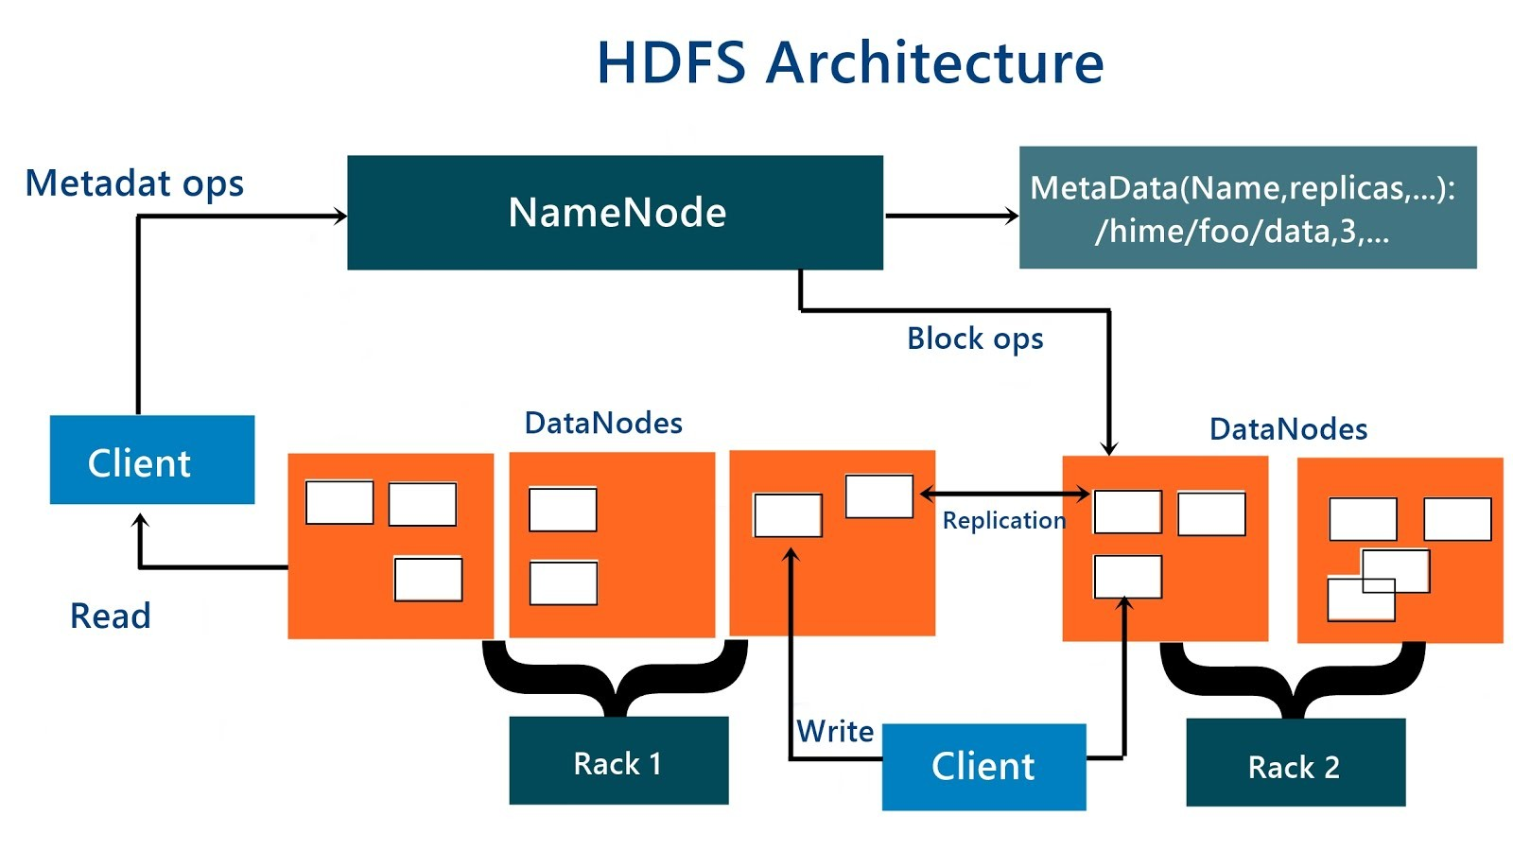
HDFS Architecture

Slide 45
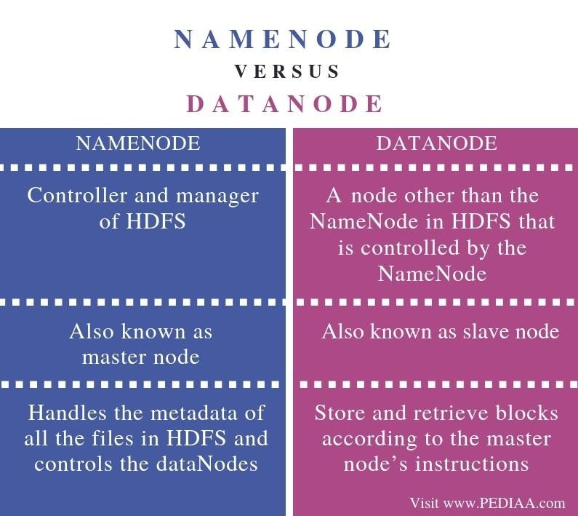

Slide 46
The Design of HDFS :
Very large files
Streaming data access
Commodity hardware : Hadoop doesn’t require expensive, highly reliable hardware. It’s designed to run on clusters of commodity hardware

Slide 47
HDFS is not a good fit today:
Low-latency data access
Applications that require low-latency access to data, in the tens of milliseconds range,will not work well with HDFS.
Lots of small files
Because the namenode holds filesystem metadata in memory, the limit to the number of files in a filesystem is governed by the amount of memory on the namenode.
Multiple writers, arbitrary file modifications
Files in HDFS may be written to by a single writer.

Slide 48
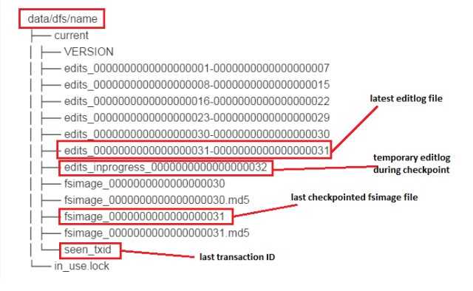
Metadata in Disk & Metadata in RAM

Slide 49
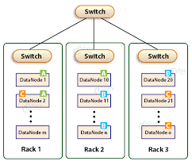
Rack aware Architecture
Two design possibilities
All Master processes/nodes reside in one Rack while the slaves will be placed in the other racks
Every rack would have one master
node

Slide 50
Rules for Data node replication
Never place the replication on the same data node where the original block resides
In case of rack aware architecture do not place a replication on the same rack where he original block resides
Never place more than two replicas of a block
in the same rack

Slide 51
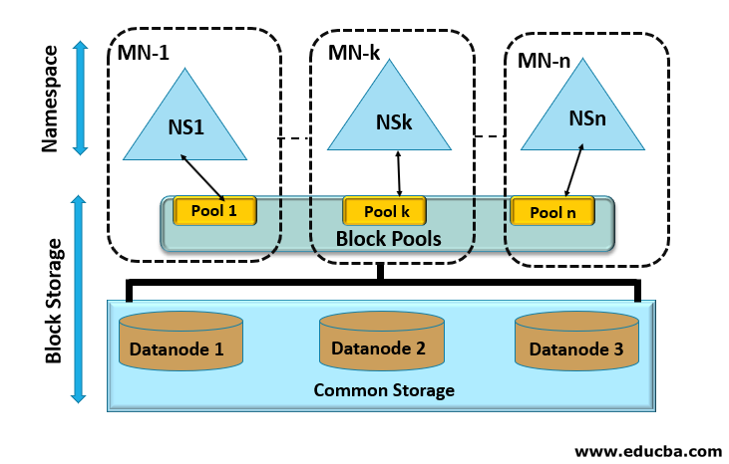
HDFS Federation

Slide 52
HDFS Federation
Federation means organizing several units of same functionality under one administration / set of rules.
The traditional hdfs architecture has been horizontally scaled to accommodate more number of Name node and Data node clusters. Thus forms the hdfs federation.
The Namespace portion consists of Name nodes and the Block storage consists of Data nodes
Within each Name node we'll have a Namespace which is a hierarchical structure of directories and files. And a block pool comprising the set of blocks corresponding to the Namespace files.
The blocks of each block pool can be stored in any of the data nodes. When a Name node is deleted its Name space , block pool also will be removed by removing those blocks from the Data nodes.

Slide 53
Refference
Tom White, "Hadoop: The Definitive Guide", 4th Edition, O'Reilly Media Inc, 2015.
Bill Chambers, Matei Zaharia, “Spark: The Definitive Guide”, 4th Edition, O'Reilly Media Inc, 2018.
Anand Rajaraman and Jeffrey David Ullman,”Mining of Massive Datasets”, 2nd Edition, Cambridge University Press, 2014.
Neha Narkhede, Gwen Shapira, Todd Palino, "Kafka: The Definitive Guide", 2nd Edition, O'Reilly
Media, 2017
Viktor Gamov, "Kafka Streams in Action", 1st Edition, Manning Publications, 2018

Slide 54
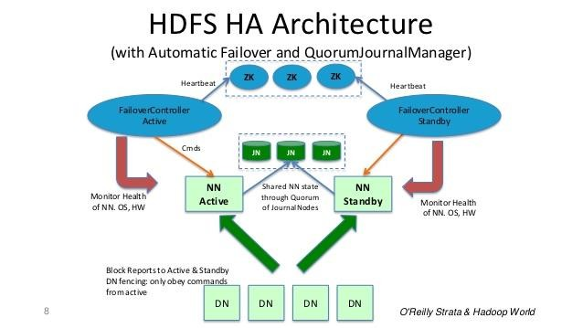

Slide 55
The HDFS High Availability Architecture
The High Availability feature of HDFS ensures the data availability to its clients inspite of Name node and Data node failure.
Data node High Availability
The data replication concept of HDFS , makes the blocks available even when one of the data nodes having a copy of the block is corrupted . When the client requests Name node for data access, then the Name node searches for all the nodes in which that data is available. After that, it provides access to that data to the user from the node in which data was quickly available.
Namenode High Availability
To provide the High Availability in case of Name node failure, the HDFS High Availability Architecture has been developed since the hadoop 2.x . In this architecture we'll have an alternative Name node called passive Name node.

Slide 56
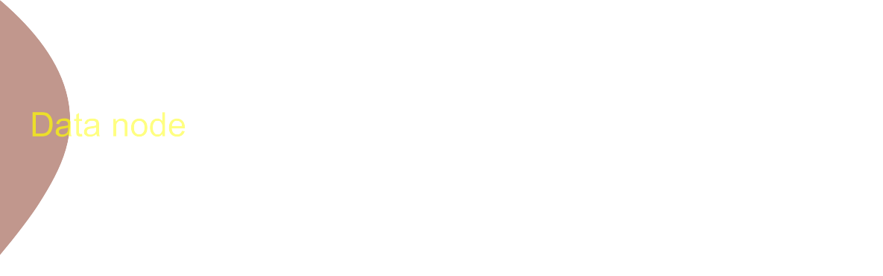









Components of HA Architecture
Min no: of Journal nodes is 3

Slide 57
Hadoop File Systems

Slide 58
S.No | File System | URI Scheme | Java Implementation | Description
1 | Local | file | fs.LocalFileSystem
2 | HDFS | hdfs | hdfs.DistribtedFileSystems | Works with MapReduce Efficiently
3 | HFTP | hftp | hdfs.HftpFileSystems | HFTP File System provides read- only access to HDFS over HTTP
4 | HSFTP | hsftp | Hdfs.HsftpFileSystem | Provides read-only access to HDFS over HTTP in a secured fashion
5 | WebHdfs | webhdfs | Hdfs.Web.WebHdfsFileSystem | File System provides secure Read-Write access to HDFS
6 | HAR | har | Fs.HarFileSystem | A FileSystem layered on another FileSystem for archieving Files
7 | KFS(Cloud- Store) | kfs | Fs.kfs.KosmosFileSystem | FileSystem that supports data intensive apps like GFS
8 | FTP | ftp | fs.ftp.FTPFileSystem | File System backed up by an FTP server
9 | S3 | S3a | fs.s3a.S3AFileSystem | A File System backed by Amazon S3. Replaces the older s3n S3native implementation
10 | Azure | wasb | fs.azure.NativeAzureFileSystem | A filesystem backed by Microsoft Azure

Slide 59







Accessing Hadoop File System using Java API
Public static FileSystem get( URI uri, Configuration conf) throws IOException Returns the File System as specified by the uri
FileSystem Configuration
FileSystem
Configuration

Slide 60



Accessing Hadoop File System using Java API
open

Slide 61
The Command-Line Interface
There are many other interfaces to HDFS, but the command line is one of the simplest and, to many developers, the most familiar.
There are two properties that we set in the pseudodistributed configuration that deserve further explanation.
The first is fs.defaultFS, set to hdfs://localhost/, which is used to set a default filesystem for HadooP.

Slide 62
Basic Filesystem Operations :
The filesystem is ready to be used, and we can do all of the usual filesystem operations, such as reading files, creating directories, moving files, deleting data, and listing directories.
You can type hadoop fs -help to get detailed help on every command.
Start by copying a file from the local filesystem to HDFS:
% hadoop fs -copyFromLocal input/docs/quangle.txt \
hdfs://localhost/user/tom/quangle.txt

Slide 63
This command invokes Hadoop’s filesystem shell command fs, which supports a number of subcommands — in this case, we are running -copyFromLocal.
The local file quangle.txt is copied to the file /user/tom/quangle.txt on the HDFS instance running on localhost.
In fact, we could have omitted the scheme and host of the URI and picked up the default, hdfs://localhost, as specified in core-site.xml:
% hadoop fs -copyFromLocal input/docs/quangle.txt /user/tom/quangle.txt
We also could have used a relative path and copied the file to our home directory in HDFS, which in this case is /user/tom:
% hadoop fs -copyFromLocal input/docs/quangle.txt quangle.txt

Slide 64
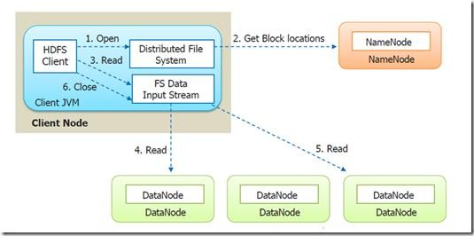
Anatomy of a File Read
The client opens the required file to be read by calling open() method on the Distributed File System object
Distributed File System calls the name node using RPC
to determine the first few blocks
Upon determining the data node with the
closest proximity, the Distributed File system returns an FSDataInputStream
The client then calls the read() method upon the FSDataInputStream
Data is streamed from the Datanode back to the client which calls read() repeatedly
When the end of the block is
reached, DFSInputStream will close the connection to the datanode, then find the best datanode for the next block
When the client has finished reading, it calls on the
close() FSDataInputStream

Slide 65






Anatomy of a File Read
DFSInputStream

Slide 66
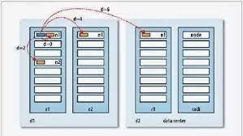



Anatomy of a File Read

Slide 67
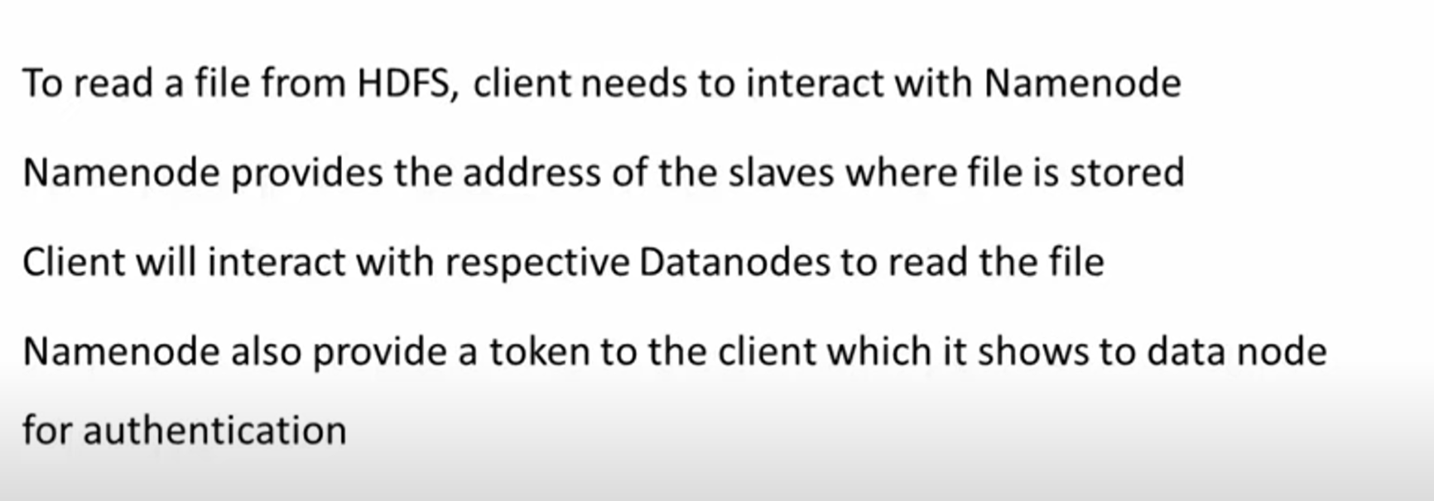

Slide 68
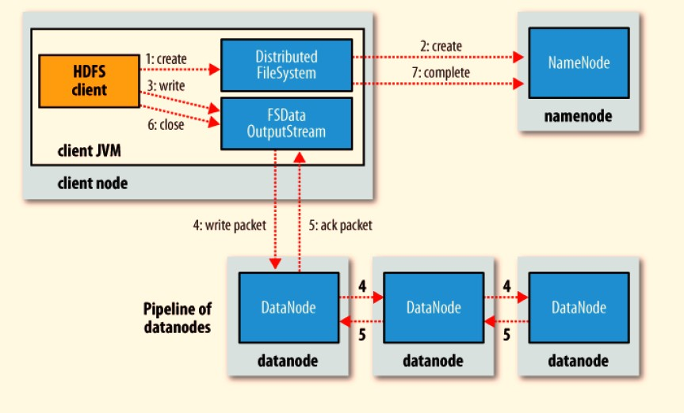
Anatomy of File Write
The client creates a new file by calling create() method on the Distributed File System object
Distributed File System calls the name node using RPC to create a new file in it's namespace with no blocks associated with it.
The namenode makes a record of the new file if the file doesn’t already exist, and that the client has the right permissions to create the file. otherwise, file creation fails and the client is thrown an IOException. The returns an
for the client Distributed File System, FS Data Output Stream
client calls a write() method and DFSOutputStream splits it into packets and it writes to an internal queue, called the data queue.
The data queue is consumed by the DataStreamer, which asks the name node to allocate new blocks by picking a list of suitable data nodes to store the replicas.

Slide 69
Anatomy of File Write
The list of data nodes forms a pipeline .
The DataStreamer streams the packets to the first data node in the pipeline, which stores the packet and forwards it to the second data node in the pipeline
DFSOutputStream also maintains an internal queue of packets that are waiting to be acknowledged by data nodes, called the ack queue. A packet is removed from the
ack queue only when it has been acknowledged by all the
data nodes in the pipeline
When the client has finished writing, it calls on the close() FSDataoutputStream
This action flushes all the remaining packets to the data node pipeline and waits for acknowledgments before contacting the name node to signal that the file is complete

Slide 70
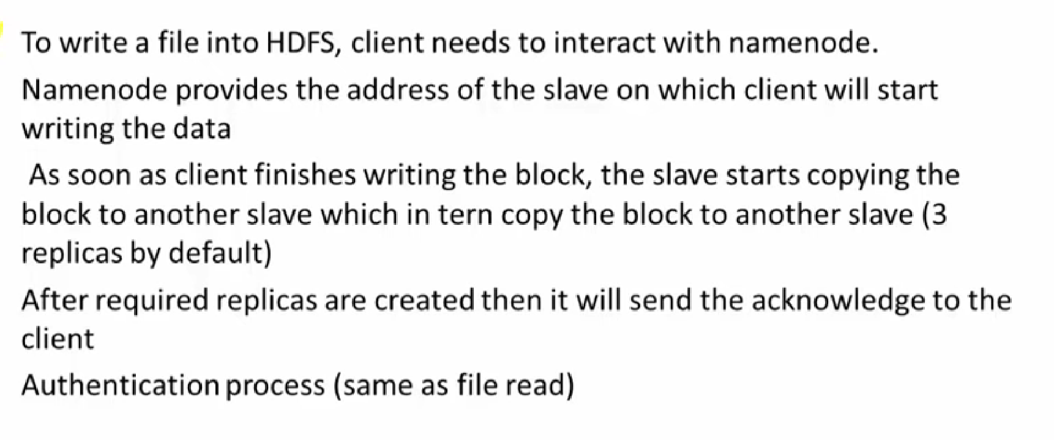

Slide 71
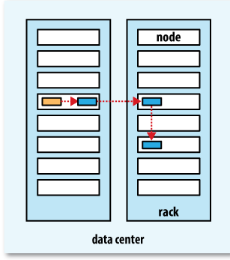
Replica Placement
Hadoop’s default strategy is to place
The first replica on the same node as the client (for clients running outside the cluster, a node is chosen at random, although the system tries not to pick nodes that are too full or too busy).
The second replica is placed on a different rack from the first (off-rack), chosen at random.
The third replica is placed on the same rack as the second, but on a different node chosen at random.
Further replicas are placed on random nodes on the cluster, although the system tries to avoid placing
too many replicas on the same rack. Once the replica locations have been chosen, a pipeline is built, taking network topology
into account.

